Slide 1

INTERNATIONAL ISLAMIC UNIVERSITY CHITTAGONG
Department of Computer and Communication Engineering
Course Code: CCE-3507
Course Title: System Analysis, Design and Development
Abu Raihan Anchari Miskat
Adjunct Faculty
Dept. of CCE, IIUC

Slide 2
COURSE OVERVIEW
Credit Hour: 2
Contact Hour: 2 period/week
Mid: 30 marks
Final: 50 marks
Assignment: 10 marks
Attendance: 10 marks

Slide 3
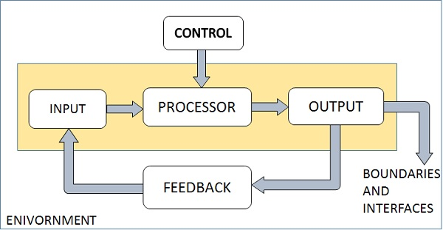
SYSTEM
What is a system?
A system is an orderly grouping of interdependent components linked together according to a plan to achieve a specific goal.

Slide 4
SYSTEM ANALYSIS AND DESIGN
System Analysis is a process of collecting and interpreting facts, identifying the problems, and decomposition of a system into its components.
System Design is a process of planning a new business system or replacing an existing system by defining its components or modules to satisfy the specific requirements.
Analysis specifies what the system should do.
System Design focuses on how to accomplish the objective of the system.

Slide 5
COMPONENTS OF A SYSTEM
Boundary
Purpose
Environment
Interface
Constraints
Output
Input

Slide 6
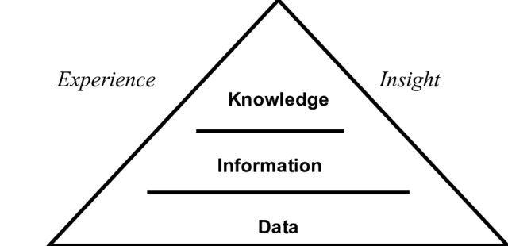
INFORMATION
What is Information?
Data that has been processed and given meaning.
Helps in decision-making and problem-solving.
Example:
  Data: “50, 60, 70”
  Information: “Average student mark is 60.”
Knowledge: Data and information that is further refined based on the facts, truths, beliefs, judgments, experiences, and expertise of the recipient.

Slide 7
TYPES OF INFORMATION
Strategic
Tactical
Operational
  Used by top level management
  Board based, mixture of primary and secondary source
  Longer timespan
  Used by middle management
  Followed by strategic decisions
  Time span 6 month to 5 years
  Lowest level
  Followed by tactical decisions
  Short timespan
  Results will be evaluated upwards

Slide 8
SOURCES OF INFORMATION
Primary Information: First-hand data collected directly from the original source.
  Example: surveys, interviews, experiments.
Secondary Information: Information already collected, processed, or published by others.
  Example: books, research articles, government reports.
Internal Information: Generated within an organization for its own use.
  Example: sales records, employee performance reports, financial statements.
External Information: Obtained from outside the organization.
  Example: competitor data, market trends, customer feedback, news reports.

Slide 9
QUALITY OF INFORMATION
(a) Availability/accessibility
(b) Accuracy
(c) Reliability
(d) Relevance/appropriateness
(e) Completeness
(f) Level of detail/conciseness
(g) Presentation
(h) Up-to-date
(i) Timing

Slide 10
INFORMATION SYSTEM
A set of devices, procedures and operating systems designed around user based criteria to produce information and communicate it to the users for planning, control and performance.
Why this is necessary:
✓ Foundation of doing business
✓ Capital Management
✓ Productivity
✓ Strategic Opportunity and Advantage

Slide 11
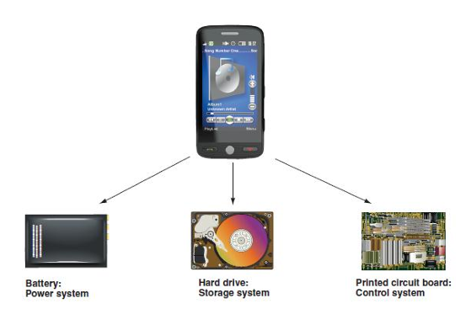
CONCEPTS ON INFORMATION SYSTEM
Decomposition: Break a system into small, manageable, and understandable subsystems
Modularity: Modularity is a direct result of decomposition.
Coupling: Coupling means that subsystems are dependent on each other.
Cohesion: Cohesion is the extent to which a subsystem performs a single function.
Fig: An MP3 player is a system with power supply, storage, and control subsystems.

Slide 12
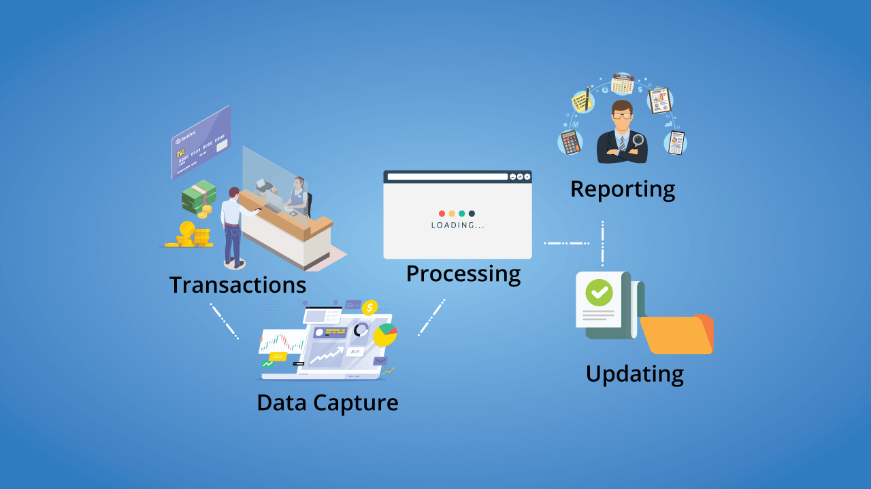
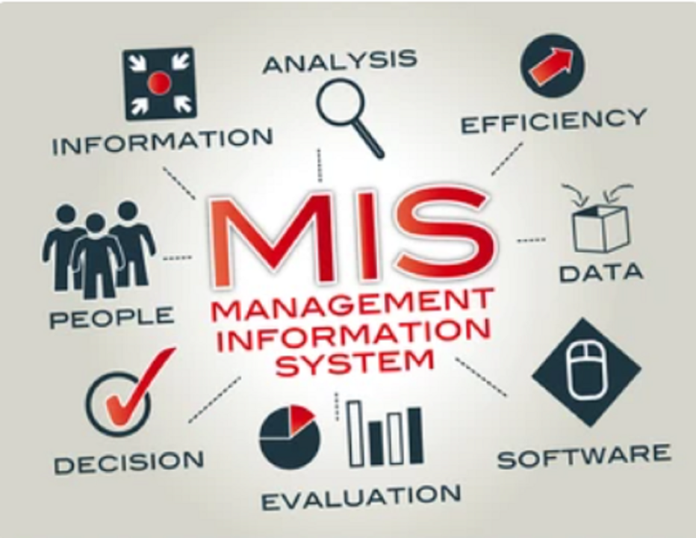
Types of Information Systems
1. Transaction processing systems (TPS): TPS, form the foundation of many businesses. These systems handle routine, day-to-day activities like billing, order processing, payroll, or reservations.
2. Management information systems (MIS): MIS take the raw data from TPS and organize it. Instead of showing every single sale, for example, an MIS might provide a daily sales report broken down by region or product type.

Slide 13
Types of Information Systems
3. Decision support systems (DSS): When decisions are unclear or involve many moving parts, organizations use decision support systems (DSS) to help them think through the possibilities. Rather than offering a final answer, these systems bring together different types of data and offer tools to run comparisons, highlight risks, simulate changes, and identify potential advantages or setbacks.
4. Executive Support Systems (ESS): ESS offer a much broader view of organizational performance. These systems are designed for senior executives who need to track long-term goals, monitor strategic outcomes, assess risks, and make decisions that guide the direction of the entire organization.

Slide 14
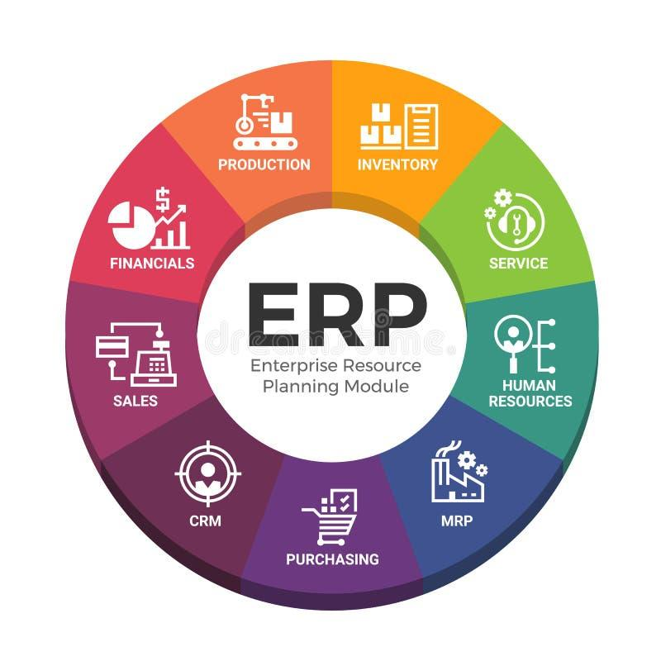
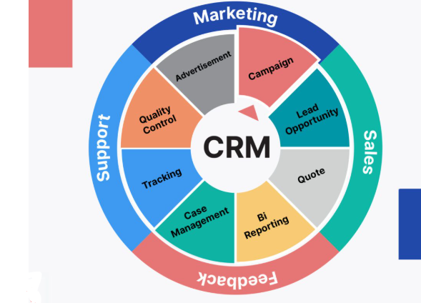
Types of Information Systems
5. Enterprise resource planning (ERP): These systems integrate core business functions like accounting, inventory, human resources, and procurement into one platform.
6. Customer relationship management (CRM): Through such systems, they gather all kinds of customer information, such as purchase history, past questions, preferences, and feedback.

Slide 15
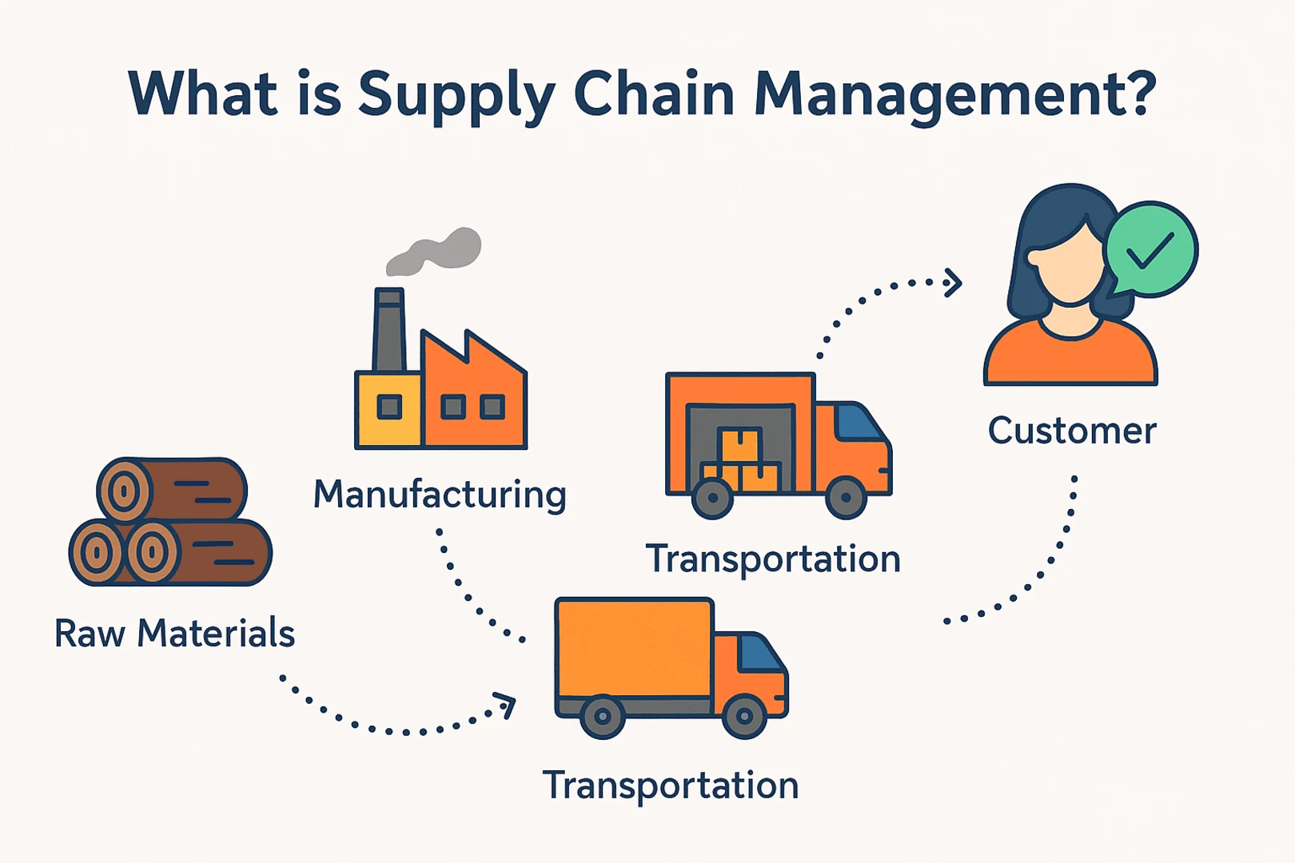
Types of Information Systems
7. Supply chain management (SCM): These systems help organizations manage their flow of goods, information, finances, scheduling, inventory, and vendor coordination.
8. Knowledge management systems (KMS): These systems capture, store, organize, and share what employees know, making it easier for others to access useful insights, learn from past outcomes, apply proven solutions, and continue building upon existing work.

Slide 16
THE SYSTEMS ANALYST
A systems analyst is an IT professional who analyzes an organization's current computer systems and procedures, then designs and implements new or improved systems to solve business problems and enhance efficiency.
Qualities of a systems analyst:
Technical skills: expertise in Analysis tools, quick adaptability with up-to-date technologies, etc.
Communication skills: strong oral and written communication skills, and the ability to interact with people at all levels
Business skill: business-oriented, curious, comfortable with financial tools
Critical thinking ability: the ability to compare, classify, evaluate, recognize patterns, analyze cause-and-effect, and apply logic.
Education: a college degree in information systems, computer science, or management information system, and some IT experience usually is required.

